Slide 1
QUESTION
OPTION 1
OPTION 2
BUTTON
OPTION 3
OPTION 4
SUBMIT

Slide 2
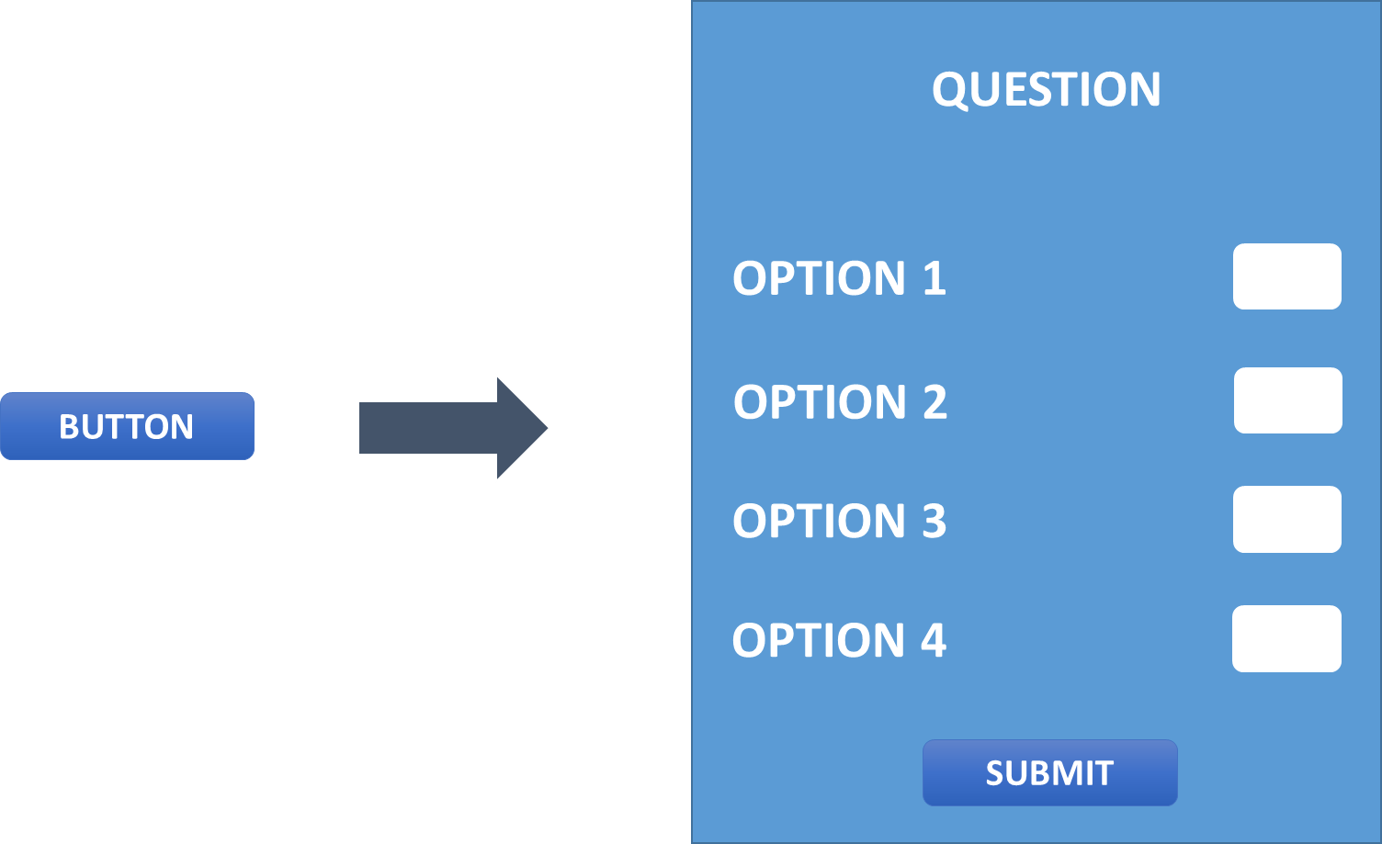

Slide 3
MULTISELECT DIALOG
SimpleDialog
DEMO PAGE
title =>
QUESTION
children =>
CheckboxListTile
OPTION 1
<= title
value =>
BUTTON
pops
OPTION 2
<= title
value =>
OPTION 3
<= title
value =>
ElevatedButton
OPTION 4
<= title
value =>
children =>
SUBMIT
Align
ElevatedButton

Slide 4
MULTISELECT DIALOG
SimpleDialog
DEMO PAGE
title =>
QUESTION
children =>
CheckboxListTile
OPTION 1
<= title
value =>
BUTTON
pops
OPTION 2
<= title
value =>
OPTION 3
<= title
value =>
ElevatedButton
OPTION 4
<= title
value =>
children =>
SUBMIT
Align
ElevatedButton

Slide 5

MULTISELECT DIALOG
SimpleDialog
DEMO PAGE
title =>
QUESTION
FORM
children =>
CheckboxListTile
OPTION 1
<= title
value =>
MULTISELECTFORMFIELD
OPTION 2
<= title
value =>
OPTION 3
<= title
value =>
GlobalKey<FormState>()
OPTION 4
<= title
value =>
children =>
SUBMIT
Align
ElevatedButton

Slide 6
IF STATE.HASERROR IS TRUE ELSE SHOW EMPTY CONTAINER
Card Container
ONTAP
ERROR!

Slide 7
DEMO PAGE
MULTISELECT DIALOG
FORM
SimpleDialog
title =>
QUESTION
MULTISELECT FORMFIELD
RETURN RESULTS
children =>
CheckboxListTile
GlobalKey<FormState>()
OPTION 1
<= title
value =>
MULTISELECT FORMFIELD
OPTION 2
<= title
value =>
COLUMN
IF STATE.HASERROR IS TRUE ELSE SHOW EMPTY CONTAINER
ONTAP
OPTION 3
<= title
value =>
CARD CONTAINER
ROW
OPTION 4
<= title
value =>
ERROR!
children =>
SUBMIT
Align
ElevatedButton

Slide 8
DEMO PAGE
MULTISELECT DIALOG
FORM
SimpleDialog
title =>
QUESTION
MULTISELECT FORMFIELD
RETURN RESULTS
children =>
CheckboxListTile
GlobalKey<FormState>()
OPTION 1
<= title
value =>
MULTISELECT FORMFIELD
OPTION 2
<= title
value =>
COLUMN
IF STATE.HASERROR IS TRUE ELSE SHOW EMPTY CONTAINER
ONTAP
OPTION 3
<= title
value =>
CARD CONTAINER
ROW
OPTION 4
<= title
value =>
ERROR!
children =>
SUBMIT
Align
ElevatedButton

Slide 9
List<String> flavours
Chocolate
Caramel
Vanilla
Peanut Butter
INDEX
0 1 2 3
?
Map<String, bool> mappedFlavours
Chocolate
Caramel
Vanilla
Peanut Butter
false
false
false
false
INDEX
0 1 2 3

Slide 10
List<String> flavours
Chocolate
Caramel
Vanilla
Peanut Butter
INDEX
0 1 2 3
convertToMap(List<String flavours)
Map<String, bool> mappedFlavours
Chocolate
Caramel
Vanilla
Peanut Butter
false
false
false
false
INDEX
0 1 2 3

Slide 11
List<String> flavours
Chocolate
Caramel
Vanilla
Peanut Butter
INDEX
0 1 2 3
LIST TEST CASES
List is null.
List is empty.
List is not empty.
List has total four flavours.
First flavour of list is Chocolate.
6. Last flavour of list is Peanut Butter.
7. List has two flavours starting with the letter C. 8. List has total fifteen vowels. 9. List has total twenty consonants. 10. Lists are not same.

Slide 12
List<String> flavours
1. List is null.
test('List is null', () => expect(flavours, isNull));

Slide 13
List<String> flavours
INDEX
0
2. List is empty.
test('List is empty', () {
flavours = [];
expect(flavours, isEmpty);
});

Slide 14
List<String> flavours
Chocolate
Caramel
Vanilla
Peanut Butter
INDEX
0 1 2 3
3. List is not empty.
test('List is not empty', () {
flavours = ['Chocolate', 'Caramel', 'Vanilla', 'Peanut Butter'];
expect(flavours, isNotEmpty);
});

Slide 15
List<String> flavours
Chocolate
Caramel
Vanilla
Peanut Butter
INDEX
0 1 2 3
Length = 4
4. List has total four flavours.
test('List has total four flavours', () {
expect(flavours.length, greaterThan(0));
expect(flavours.length, lessThan(5));
});

Slide 16
List<String> flavours
Chocolate
Caramel
Vanilla
Peanut Butter
INDEX
0 1 2 3
FIRST
5. First flavour of list is Chocolate.
test('First flavour of list is Chocolate',
() => expect(flavours.first, equals('Chocolate')));

Slide 17
List<String> flavours
Chocolate
Caramel
Vanilla
Peanut Butter
INDEX
0 1 2 3
LAST
6. Last flavour of list is Peanut Butter.
test('Last flavour of list is Peanut Butter',
() => expect(flavours.last, isNot(equals('Chocolate'))));

Slide 18
List<String> flavours
Chocolate
Caramel
Vanilla
Peanut Butter
INDEX
0 1 2 3
7. List has two flavours starting with the letter C
test(
'List has two flavours starting with letter C',
() => expect(
flavours.where((flavour) => flavour.startsWith('C')).length,
equals(2))
);

Slide 19
List<String> flavours
ooae
aae
aia
eau ue
INDEX
0 1 2 3
8. List has total fifteen vowels.
test('List has total fifteen vowels', () {
var vowels = [];
flavours.forEach((flavour) =>
vowels.add(flavour.split(RegExp('[^aeiouyAEIOUY0-9\W]+')).join()));
expect(vowels.join().length, equals(15));
});

Slide 20
List<String> flavours
Chclt
Crml
Vnll
PntBttr
INDEX
0 1 2 3
9. List has total twenty consonants.
test('List has total twenty consonants', () {
var consonants = [];
flavours.forEach((flavour) =>
consonants.add(flavour.split(RegExp(r'[AaEeIiOoUu ]')).join()));
expect(consonants.join().length, equals(20));
});

Slide 21
List<String> flavours
Chocolate
Caramel
Vanilla
Peanut Butter
INDEX
0 1 2 3
≠
INDEX
0 1 2 3
10. Lists are not same.
test('Lists are not same', () {
expect(flavours == [], isFalse);
});

Slide 22
Map<String, bool> mappedFlavours
Chocolate
Caramel
Vanilla
Peanut Butter
false
false
false
false
INDEX
0 1 2 3
MAP TEST CASES
Map is not null.
Map is empty.
Map Key is a string.
Map Value is a bool.

Slide 23
Map<String, bool> mappedFlavours
Map is not null.
test('Map is null', () => expect(mappedFlavours, isNotNull));

Slide 24
Map<String, bool> mappedFlavours
INDEX
0
2. Map is empty.
test('Map is empty', () {
expect(mappedFlavours, isEmpty);
});

Slide 25
Map<String, bool> mappedFlavours
KEY
== STRING
INDEX
0
3. Map Key is a string.
test('Map Key is a string',
() => expect(mappedFlavours.keys.runtimeType != int, isTrue));

Slide 26
Map<String, bool> mappedFlavours
VALUE
INT ==
INDEX
0
4. Map Value is a bool.
test('Map Value is a bool',
() => expect(mappedFlavours.values.runtimeType == String, isFalse));

Slide 27
convertToMap(List<String flavours)
FUNCTION TEST CASES
convertToMap requires a List<String> Parameter.
convertToMap return type is Map<String,bool>.
mappedFlavour should not be empty.

Slide 28
convertToMap()
X
convertToMap(List<String flavours)

convertToMap requires a List<String> Parameter.
test('convertToMap requires a List<String> Parameter',
() => expect(convertToMap == () => {'': false}, isFalse));

Slide 29
X
returns
convertToMap(List<String flavours)
0

convertToMap(List<String flavours)
returns
{'':false}
2. convertToMap return type is Map<String,bool>.
test('convertToMap return type is Map<String,bool>', () {
var tempFunction = (List<String> temp) => Map<String, bool>();
expect(convertToMap.runtimeType, isNot(equals((List<String> temp) => 0)));
expect(convertToMap.runtimeType, equals(tempFunction.runtimeType));
});

Slide 30
convertToMap(List<String flavours)
INDEX
0
Map<String, bool> mappedFlavours
Chocolate
Caramel
Vanilla
Peanut Butter
false
false
false
false
INDEX
0 1 2 3
Map<String, bool> mappedFlavours
3. mappedFlavour should not be empty.
test('mappedFlavour should not be empty', () {
if (mappedFlavours.isEmpty) {
mappedFlavours = convertToMap(flavours);
}
expect(mappedFlavours, isNotEmpty);
});

Slide 31
convertToMap(List<String flavours)
Chocolate
Caramel
Vanilla
Peanut Butter
false
false
false
false
INDEX
0 1 2 3
Map<String, bool> mappedFlavours
INDEX
0
Map<String, bool> mappedFlavours
POST CONVERSION TEST CASES
mappedFlavour has no key Cherry.
mappedFlavour has no value 0.
mappedFlavour has no blank entries.

Slide 32
Chocolate
Caramel
Vanilla
Peanut Butter
Cherry
false
false
false
false
false
INDEX
0 1 2 3 4
Map<String, bool> mappedFlavours
mappedFlavour has no key Cherry.
test('mappedFlavour has no key Cherry',
() => expect(!mappedFlavours.containsKey('Cherry'), isTrue));

Slide 33
Chocolate
Caramel
''
Vanilla
Peanut Butter
false
false
0
false
false
INDEX
0 1 2 3 4
Map<String, bool> mappedFlavours
2. mappedFlavour has no value 0.
test('mappedFlavour has no value 0',
() => expect(!mappedFlavours.containsValue(0), isTrue));

Slide 34
Map<String, bool> mappedFlavours
Map<String, bool> mappedFlavours
''
''
''
''
Chocolate
Caramel
Vanilla
Peanut Butter
''
''
''
''
false
false
false
false
0 1 2 3
INDEX
0 1 2 3
INDEX
X

3. mappedFlavour has no blank entries.
test(
'mappedFlavour has no blank entries',
() => expect(
mappedFlavours.containsKey('') && mappedFlavours.containsValue(''),
isFalse)
);

